Slide 1




Bootstrap 3
SoftUni Team
Technical Trainers
Software University
http://softuni.bg

Slide 2


Table of Contents
What is Bootstrap?
How to import it?
How grid system works
Styling for the most used elements.

Slide 3
Have a Question?
sli.do #CSharpWeb

Slide 4
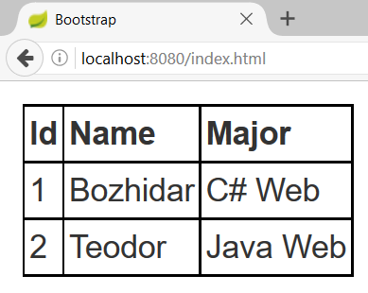
HTML Table
index.html
index.css
<table>
<tr>
<th>Id</th>
<th>Name</th>
<th>Major</th>
</tr>
<tr>
<td>1</td>
<td>Bozhidar</td>
<td>C# Web</td>
</tr>
…
</table>
table {
margin: 10px;
}
table, th, td {
border: 1px
solid
black;
border-collapse: collapse;
padding: 2px;
}
Table row
Table header
Table data

Slide 5

Bootstrap

Slide 6
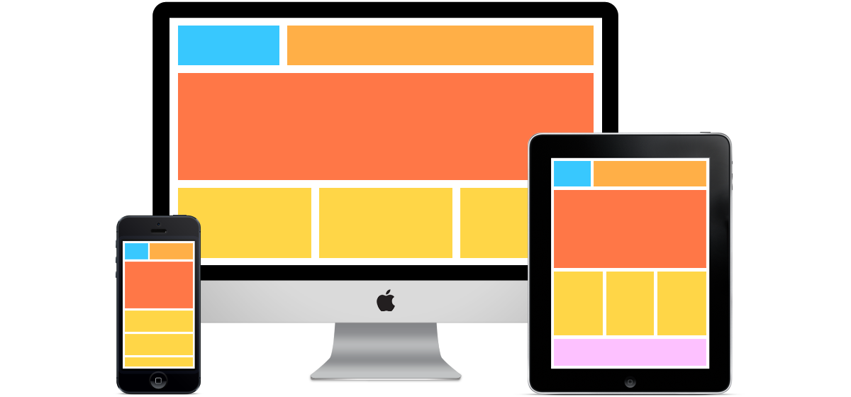
What is a Responsive Design?
Presentation layers that adjust according to the screen size of the different devices
Desktop layouts
Tablet layouts
Mobile layouts

Slide 7
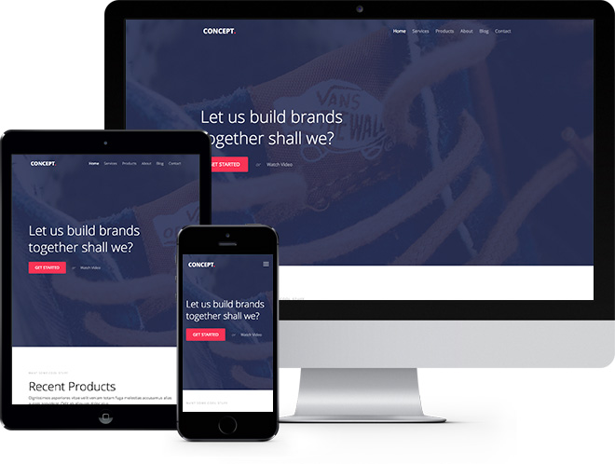
Bootstrap
Free front-end framework that provides capabilities to ensure responsive design

Slide 8
Bootstrap Import Option 1
<link rel="stylesheet" href="https://maxcdn.bootstrapcdn.com/bootstrap/3.3.7/css/bootstrap.min.css"/>
<script src="https://ajax.googleapis.com/ajax/libs/jquery/3.1.1/jquery.min.js"/>
<script src="https://maxcdn.bootstrapcdn.com/bootstrap/3.3.7/js/bootstrap.min.js"/>

Slide 9
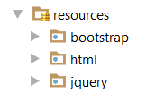
Bootstrap Import Option 2
<link rel='stylesheet' href='../bootstrap/css/bootstrap.min.css'/>
<script src="../jquery/jquery.min.js"></script>
<script src="../bootstrap/js/bootstrap.min.js"></script>

Slide 10
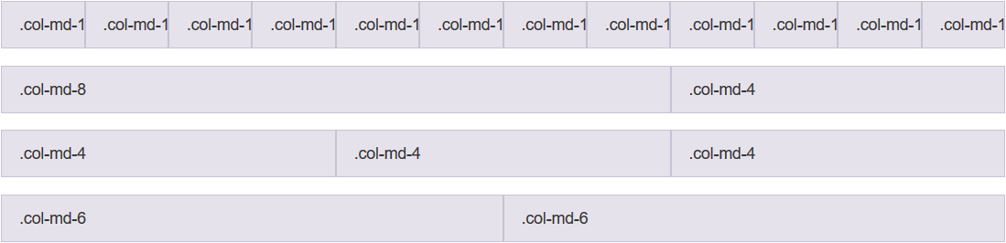
Grid System
Bootstrap includes a responsive, mobile first fluid grid system that appropriately scales up to 12 columns
Col 1
Col 2
Col 12
Row 1
Row 2
Row 3
Row 4

Slide 11
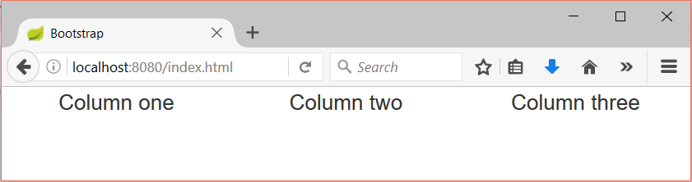
Grid System Demo
index.html
index.css
…
<div class="container-fluid">
<div class="row">
<div class="col-sm-4">Column one</div>
<div class="col-sm-4">Column two</div>
<div class="col-sm-4">Column three</div>
</div>
</div>
…
div {
text-align: center;
}
Container
Row
Columns

Slide 12
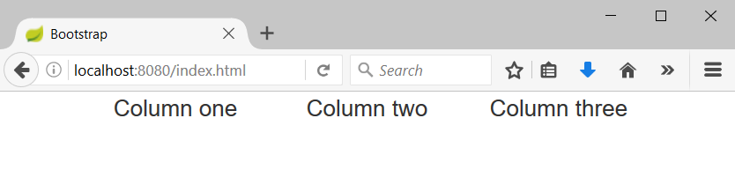
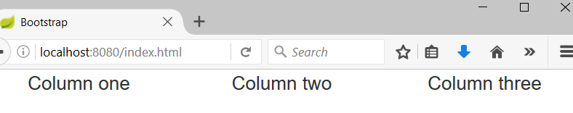
Containers
Rows must be placed in containers
.container is fixed-width
.container-fluid is full-width
Leaves margin
Full width, no margins

Slide 13
Column Classes
Determines how many columns to use on different screen sizes
.col-xs: Width Less than 768px
.col-sm: Width Between 768px and 992px
.col-md: Width Between 992px and 1200px
.col-lg: Width Over 120px
index.html
<div class="col-sm-8 col-lg-4">Column one</div>
<div class="col-sm-2 col-lg-4">Column two</div>
<div class="col-sm-2 col-lg-4">Column three</div>

Slide 14
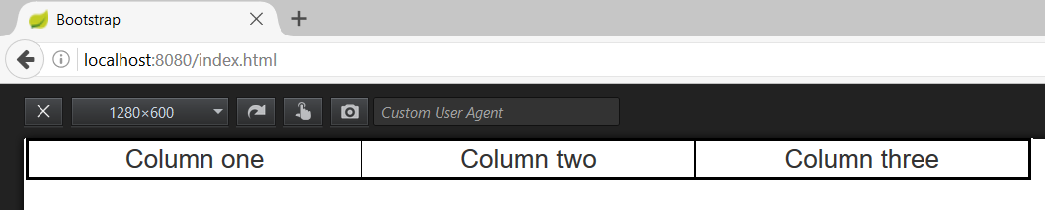
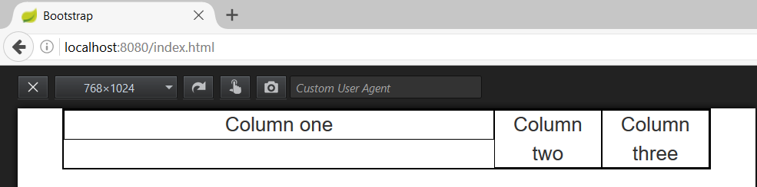
Column Classes (2)
index.html
<div class="col-sm-8 col-lg-4">Column one</div>
<div class="col-sm-2 col-lg-4">Column two</div>
<div class="col-sm-2 col-lg-4">Column three</div>
Width 1280px
Width 768px

Slide 15
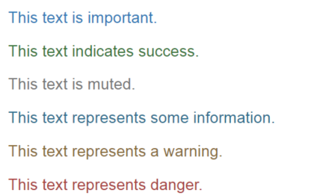
Typography with Bootstrap
Provide information about the role of the text
More on typography
index.html
<p class="text-primary">This text is important.</p>
<p class="text-success">This text indicates success.</p>
<p class="text-muted">This text is muted.</p>
<p class="text-info">This text represents some information.</p>
<p class="text-warning">This text represents a warning.</p>
<p class="text-danger">This text represents danger.</p>

Slide 16
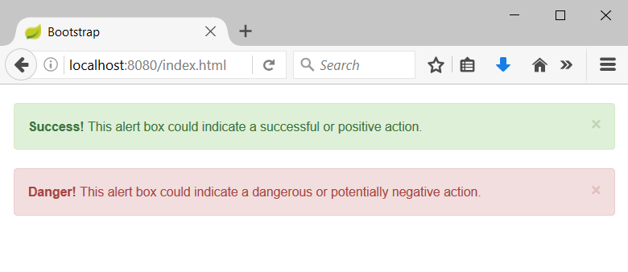
Alerts with Bootstrap
Provide information about the outcome of an event
index.html
<div class="alert alert-success alert-dismissable">
<a class="close" data-dismiss="alert" aria-label="close">×</a>
<strong>Success!</strong> This alert box could indicate a successful or positive action.
</div>
…

Slide 17
Buttons – coloring with Bootstrap
Provide information about the role of the button
index.html
<button type="button" class="btn btn-default">Default</button>
<button type="button" class="btn btn-primary">Primary</button>
<button type="button" class="btn btn-success">Success</button>
<button type="button" class="btn btn-info">Info</button>
<button type="button" class="btn btn-warning">Warning</button>
<button type="button" class="btn btn-danger">Danger</button>
<button type="button" class="btn btn-link">Link</button>

Slide 18
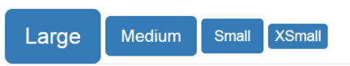
Buttons – sizing with Bootstrap
Provide information about the size of the button
More on buttons
index.html
<button type="button" class="btn btn-primary btn-lg">Large</button>
<button type="button" class="btn btn-primary btn-md">Medium</button>
<button type="button" class="btn btn-primary btn-sm">Small</button>
<button type="button" class="btn btn-primary btn-xs">XSmall</button>

Slide 19

Icons with Bootstrap
Visualize a given icon from the standard bootstrap icons-sheet
If you want to use a different icon, simply change “glyphicon-cloud” to “glyphicon-iconName”
Bootstrap’s icons
index.html
<span class="glyphicon glyphicon-cloud"></span>

Slide 20
Nav and Navbar with Bootstrap
index.html
<div class="navbar navbar-default">
<div class="container-fluid">
<div class="navbar-header">
<a class="navbar-brand">Logo</a>
</div>
<ul class="nav navbar-nav">
<li class="active"><a href="">Home</a></li>
<li><a href="">About</a></li>
<li><a href="">Contact us</a></li>
</ul>
</div>
</div>

Slide 21
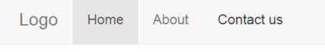
Nav and Navbar with Bootstrap(2)
The code from the previous slide shows the following:
There can be many ways to modify and position the navbar, so you may want to check out the other options

Slide 22
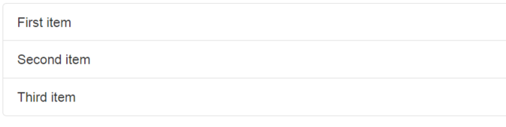
Lists with Bootstrap
Provide information about the size of the button
More on lists
index.html
<ul class="list-group">
<li class="list-group-item">First item</li>
<li class="list-group-item">Second item</li>
<li class="list-group-item">Third item</li>
</ul>
Provide information about the size of the button
More on buttons

Slide 23
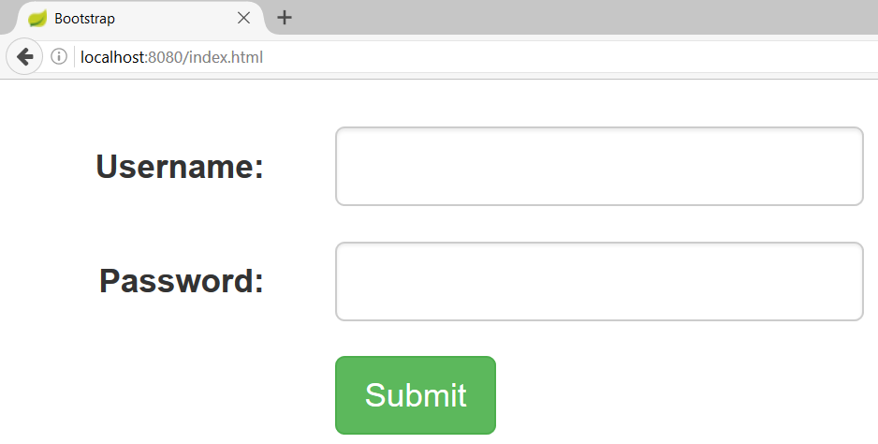
Form with Bootstrap
index.html
<form class="form-horizontal">
<div class="form-group">
<label class="control-label col-sm-2">Username:</label>
<div class="col-sm-4">
<input class="form-control" type="text"/>
</div>
</div> …
</form>

Slide 24
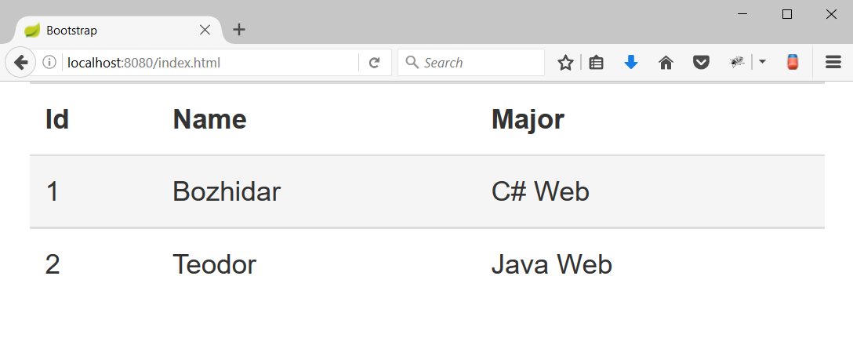
HTML Table with Bootstrap
Hover effect
index.html
<table class="table table-hover">
<tr>
<th>Id</th>
<th>Name</th>
<th>Major</th>
</tr>
<tr>
<td>1</td>
<td>Bozhidar</td>
<td>C# Web</td>
</tr>
…
</table>
Bootstrap table

Slide 25
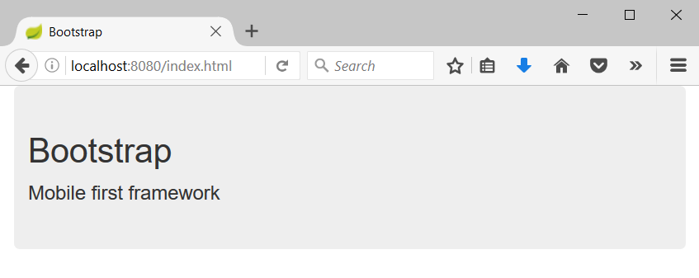
Jumbotron
Big box that provides information
index.html
<div class="container">
<div class="jumbotron">
<h1>Bootstrap</h1>
<p>Mobile first framework</p>
</div>
</div>

Slide 26

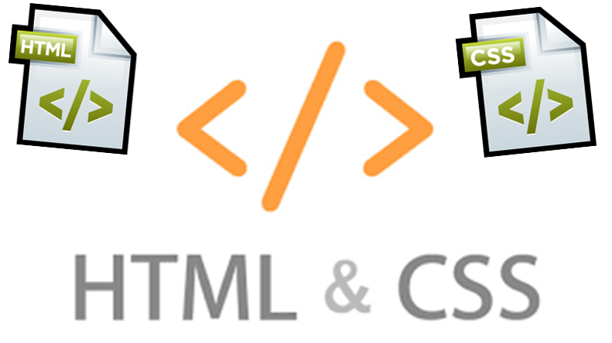
Summary
Bootstrap provides an easy way to create responsive design that fits on all screens

Slide 27








Web Development Basics – Bootstrap
https://softuni.bg/courses/

Slide 28
License
This course (slides, examples, demos, videos, homework, etc.) is licensed under the "Creative Commons Attribution-NonCommercial-ShareAlike 4.0 International" license

Slide 29





Free Trainings @ Software University
Software University Foundation – softuni.org
Software University – High-Quality Education, Profession and Job for Software Developers
softuni.bg
Software University @ Facebook
facebook.com/SoftwareUniversity
Software University Forums – forum.softuni.bg

